Slide 1
MEDICINE REMINDER AND RECORD APP IN ANDROID
PRAYAS NAG 34200115034 KAUSHIK PALUI 34200115023 RAIMA BANERJEE 34200115037
UNDER THE GUIDANCE OF OUR MENTOR
DR. JAYDIP NATH, DEPT. OF CSE

Slide 2
Overview
A Study of Android app development
and backend data analysis
Project objective
To make an android app for patients to keep track of their medical needs
Patients, doctors and pharmaceutical companies
Target audience

Slide 3
OVERVIEW
our goal was to develop an app that would help the users to keep track of their medicine records and to timely notify them about their medicines and doctor’s appointments.
Users would have to manually upload the necessary medicines and the time at which these are to be consumed, and the app would notify them timely.
Through this app, the user will have a one stop medical reminder of all his/her medical needs.
Moreover, our plan is to develop a vast database of medicines that are consumed by the users, and make regular analysis of the medicines that are in demand in the market.

Slide 4
UNDERSTANDING THE PROBLEM
01
The whole idea of this work started from the act of forgetting.
02
There are times when our parents, often forget to timely intake newly prescribed medicines by the doctor. Sometimes, these medicines are of utmost importance and forgetting to consume them might lead to severe adverities.
03
Moreover, this problem is common and persistent in the old and aged people, who often live alone for the most of the time.
04
Also, we found a need for a centralized database of medicine used by the public and gather as much information needed for analytical purpose.

Slide 5
PROJECT OBJECTIVE
we thought, we could bring the idea of this app which would help the users of all demographics. The app would keep track of the medicines and notify the users timely. Moreover, the users can save their prescriptions and appointments with the doctor in the app.
On the other hand, with growing number of users, the app would generate a huge amount of data, which can be used by pharmaceutical organisations to analyse the data and gather necessary information.

Slide 6
TARGET USER
Patients who tend to forget their regular medicines, due to medical conditions or otherwise
Patients who are old and aged and fail to clearly understand the prescription
Doctors who are willing to provide a easier route for their patients regarding their regular medicine and checkup
Medical representatives and pharmaceutical organisations for their analytical research

Slide 7
SYSTEM FEATURES
The user has to input the medicines for which they want to be alerted. These inputs will be accompanied with, start date, end date, regular timings, doctor’s name and current stock.
My Stats section will contain copies of prescriptions and reports. This section will present a detailed analysis to the user about his/her medical history
The section, ‘My Calendar’ will have the medicine alerts of each day
The Emergency section will contain information which can be used in case of emergency
Outside the app, an explicit intent will provide regular alarms about the medicines at required times.

Slide 8
APP DATA
The backend of the app will be handled in firebase by google
Users will have to register a account and should be identified uniquely
Each user will have a database which will store - user id, age, current medicines, past reports, medical history
This data can be later used by medical practitioners and pharmaceutical organisations to analyse the data and gather necessary information

Slide 9
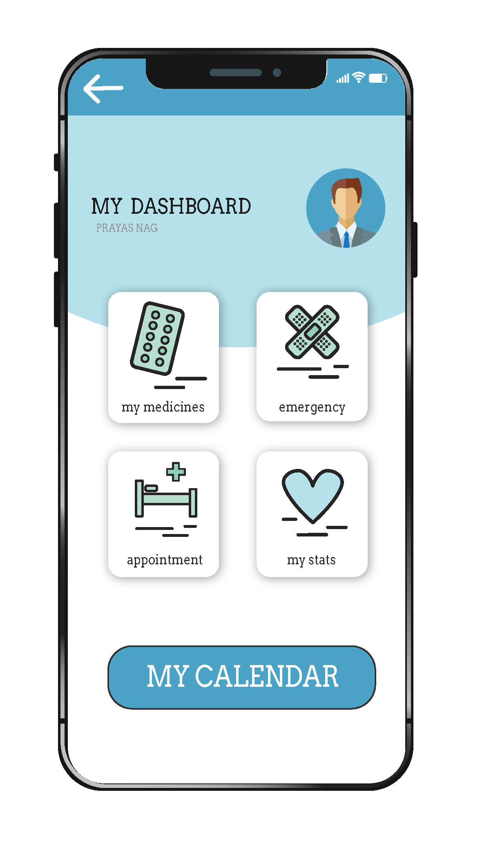
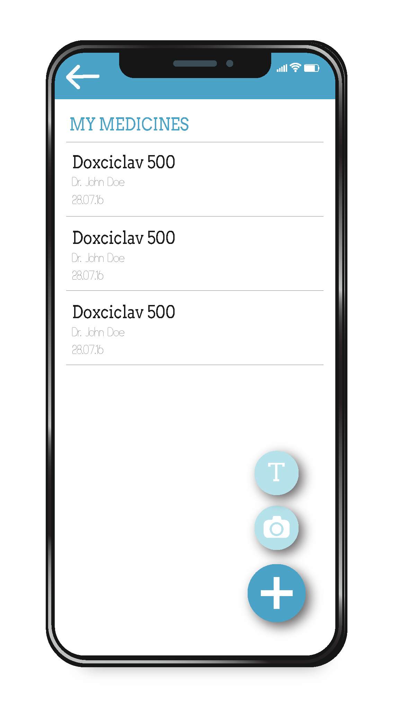
APP USER INTERFACE (1)

Slide 10
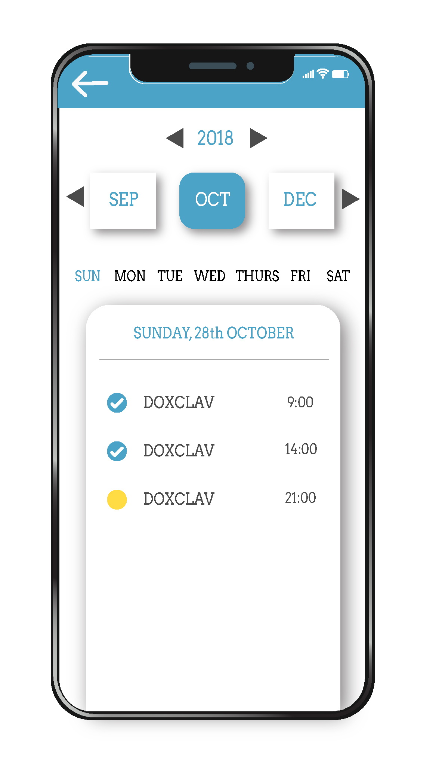
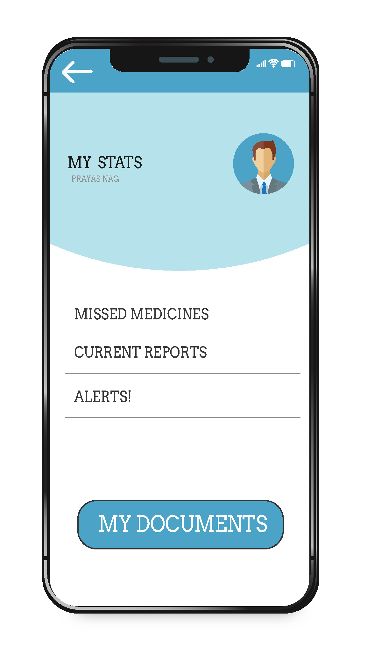
APP USER INTERFACE (2)

Slide 11
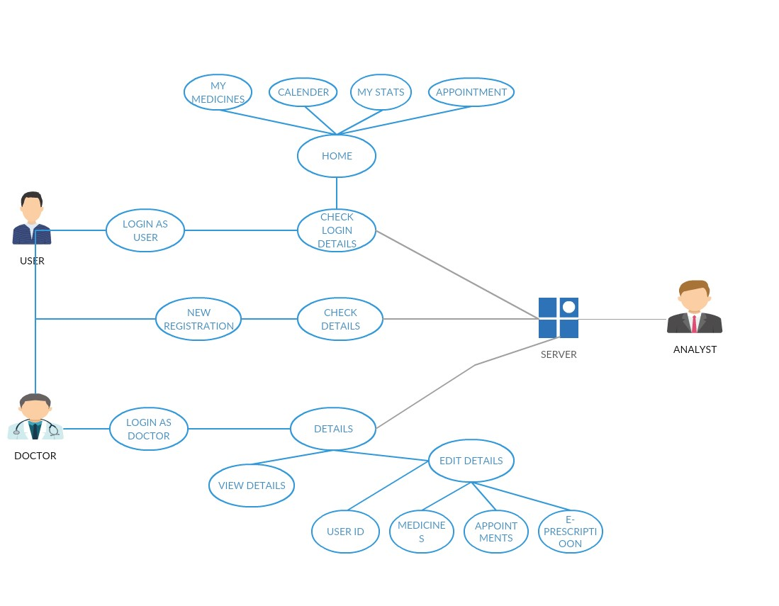
USE CASE DIAGRAM

Slide 12
SOFTWARE QUALITY ATTRIBUTES
RELIABILITY
MAINTAINABILITY
USABILITY
SECURITY
CORRECTNESS

Slide 13
FUTURE SCOPE
Currently this system is taking input from the user himself which may seem difficult for some user.
There are also future scope to upgrade our application for booking appointments.
Provisions can be added for searching nearby hospitals and medical stores
Also, an online medical e-commerce can be added which will automatically update needed medicines to the cart
Cost analysis of users medical needs can be added

Slide 14
CONCLUSION
Our project is only a humble venture to satisfy the needs in a patient whose life rely on medicines. Several user friendly coding have also adopted. This package shall prove to be a powerful package in satisfying all the requirements of the patient along with the medicine industry.

Slide 15
BIBLIOGRAPHY
https://developer.android.com/docs/
https://firebase.google.com/docs/android/setup
https://www.softwaretestinghelp.com/what-are-the-quality-attributes/
http://marathon.csee.usf.edu/~sarkar/IEEEformat.html
https://www.elprocus.com/what-is-android-introduction-features-applications/

Slide 16

Thank you!

